Slide 1



SELF EVALUATION IN THE ITALIAN SCHOOL SYSTEM
Training Event 30 January 2017 - 3 february 2017 Spain - Madrid

Slide 2

Differently from other european school systems, Italy has only recently started to define an evaluation program both for the general educational system and for
single schools

Slide 3
The National Evaluation System has different purposes:
helping each school to keep under control its own provided education and do its best for improving the control on the quality of it
providing the Ministry of Education with useful information in order to plan supporting actions for the schools that need them
evaluating headteachers
showing the results of educational action outside school

Slide 4
On the 28th of march 2013, in cooperation with the Minister of Education University and Research, the Council of Ministers approved the act regulating the National System of Evaluation.
With this act Italy aligns itself to the other European countries in the field of evaluation of public education systems

Slide 5
Steps in the self evaluation process
The process of evaluation is based on four essential steps:
a) self evaluation of schools
b) improvement actions
c) external evaluation from specific boards coordinated by a technical director leading to a revision of schools’ improvement plans
d) public report of the results

Slide 6
SCHOOL SELF EVALUATION
It is based on data collected from:
databanks of the information system of the Ministry of Education
INVALSI (National Institute of Evaluation of Educational System) through periodical monitoring
data collected from schools themselves
The evaluation ends with a self evaluation report (RAV) and with the elaboration of an improvement plan.

Slide 7
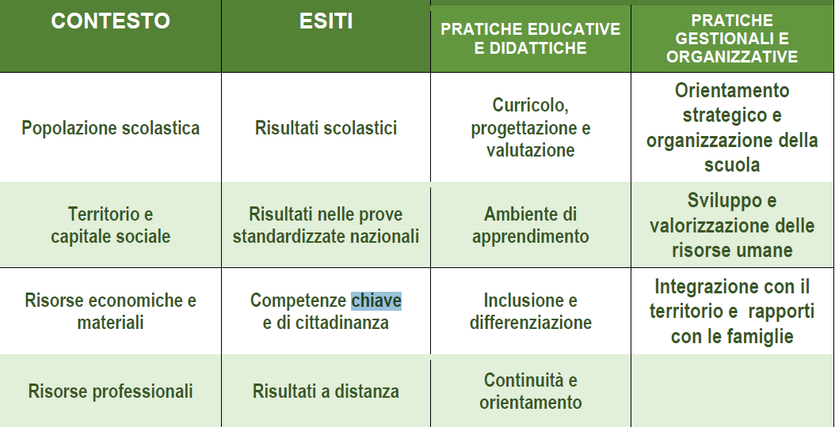
The first three sections of the Self evaluation Report are:
Context - Results - Processes. The section “Processes” is divided in “Didactic and educational practices” and “Managing and organization practices”

Slide 8
For each of the three sections (Context, Results and Processes) the Report:
- defines the area and gives a certain number of indicators
- proposes guide questions and requires to put into evidence opportunities and limits (only for the Context area)
- requires to define strong points and weak points (for the section Results and Processes) and defines a general criterion of quality
- requires to motivate the self evaluation estimation
The fourth section: critical reflections about the self evaluation path
The fifth sections requires some choices to be made by schools on the basis of priorities and goals to be achieved through the following Improvement Plan

Slide 9

The context analysis
The Context has to be described and not evaluated. The purpose is to allow schools to analyse the characteristics of the reference context and put into evidence limits and opportunities for each area.

Slide 10

Evaluating the results

Slide 11
The analysis and evaluation of results are very important because the actions of improvement will be based on the critical points highlighted in this section.
In the area of school results some elements have a special relevance:
the number of school drop-outs
the comparison with other schools operating in the same conditions
the students’ success at the end of their studies, in the following training paths and in the work field (Distance results)

Slide 12
Evaluation of processes
To analyse and evaluate processes, it is important to consider the quality and quantity of the informations available for the school
Pinpoint priorities
“General goals that the schools wants to attain on the long term”

Slide 13

Defining process aims
These are operational objectives to be achieved on the short term (a school year) and they concern one or more “process areas”
The objectives must be a limited number and have to be defined coherently with the context situation and with the available resources .

Slide 14
IMPROVEMENT ACTIONS
The improvement actions are contained in the Improvement Plan (PDM), a document integrating the Three years Plan for Educational offering (PTOF) of each school.
Since school year 2015/2016 every school has to produce an improvement plan in order to achieve the goals related to the priorities of the Self Evaluation Report

Slide 15
What is improvement?
“Improvement” is the process that the school undertakes in order to:
increase the learning level of the students
the quality of Education Offer
bring innovation in the learning environment

Slide 16
Structure of the Improvement Plan
Reference background and context analysis
Guidelines of the Improvement Plan referred to the Results area and Processes area
Analysis of Possibility of action and Impact
Main strategies of the Plan and indicators of process
Projects that are coherent with the strategic points of the plan
Il PDM prevede le seguenti sezioni:

Slide 17
Characteristics of the Improvement Plan (PDM)
A good Improvement Plan must:
pinpoint the expected results and the time span (short term: 1 school year; long term: 2 or 3years)
Establish the actions to be undertaken using indicators that must be observable and measurable in order to allow a periodical monitoring
Describe the activities on which actions are to be taken and the subjects that are involved

Slide 18
Revision of the Improvement Plan
The Improvement Plan is strictly connected with the Educational Offering Plan, being part of it .
The Improvement Plan is updated every year after:
Revision of the Self evaluation Report (RAV)
Self evaluation of the school concerning the monitoring of projects included in the Educational Offering Plan
feedback of the results obtained in National Tests about Italian and Mathematics
Inspection of the Board of External Evaluation

Slide 19
EXTERNAL EVALUATION
The External Evaluation is oriented towards school Improvement . It is carried on by the Board for External Evaluation
The Board consists of three members:
Technical Director of Ministry of Education
Professional operator from the school sector (headteacher or teacher)
Expert coming from outside the school sector with experience in social and evaluation research

Slide 20
Tasks of the Board of External Evaluation
The external evaluation consists of three steps:
before visiting the school,the Board of External Evaluation analyzes documents and data
during the inspection, there is a further gathering of data and informations through interviews, documents analysis and observation of spaces
after the inspection, the board formulate a motivated judgement about the school, writes the external evaluation report and gives the results to the school; these results will be used by the school to update and revise the Improvement Plan.

Slide 21
PUBLIC REPORT
The success of the Educational Offering Plan, of the Improvement Plan and of the self evaluation process is connected with the involvement of the whole school community.
Sharing and dissemination activities take place through
periodical reports
monitoring of projects and dissemination of results among school collective bodies ( Teachers Council, class councils, parents assemblies)
internal communications
publication of documents in the official school register
information through the official web site
social report (finale moment) addressed also to stakeholders .

Slide 22

“Or tu chi se’, che vuo’ sedere a scranna, per giudicar di lungi mille miglia con la veduta corta d’una spanna?”
Dante Alighieri, Paradiso, canto XIX, 79-81

Slide 23


This work is licensed under a Creative Commons Attribution-NonCommercial 4.0 International License.

