Slide 1

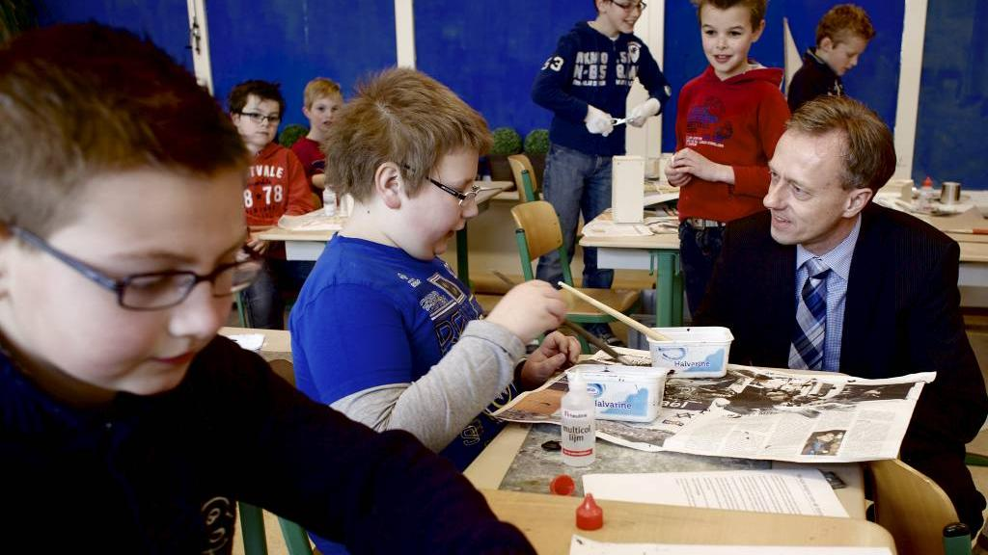



Selfregulation

Slide 2

Accountability ,
sharing results

Slide 3
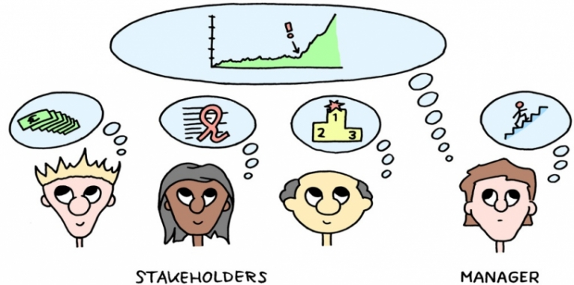
Different stakeholders:
1. Inspectorate of Education
2. Board of Directions
3. Parents

Slide 4

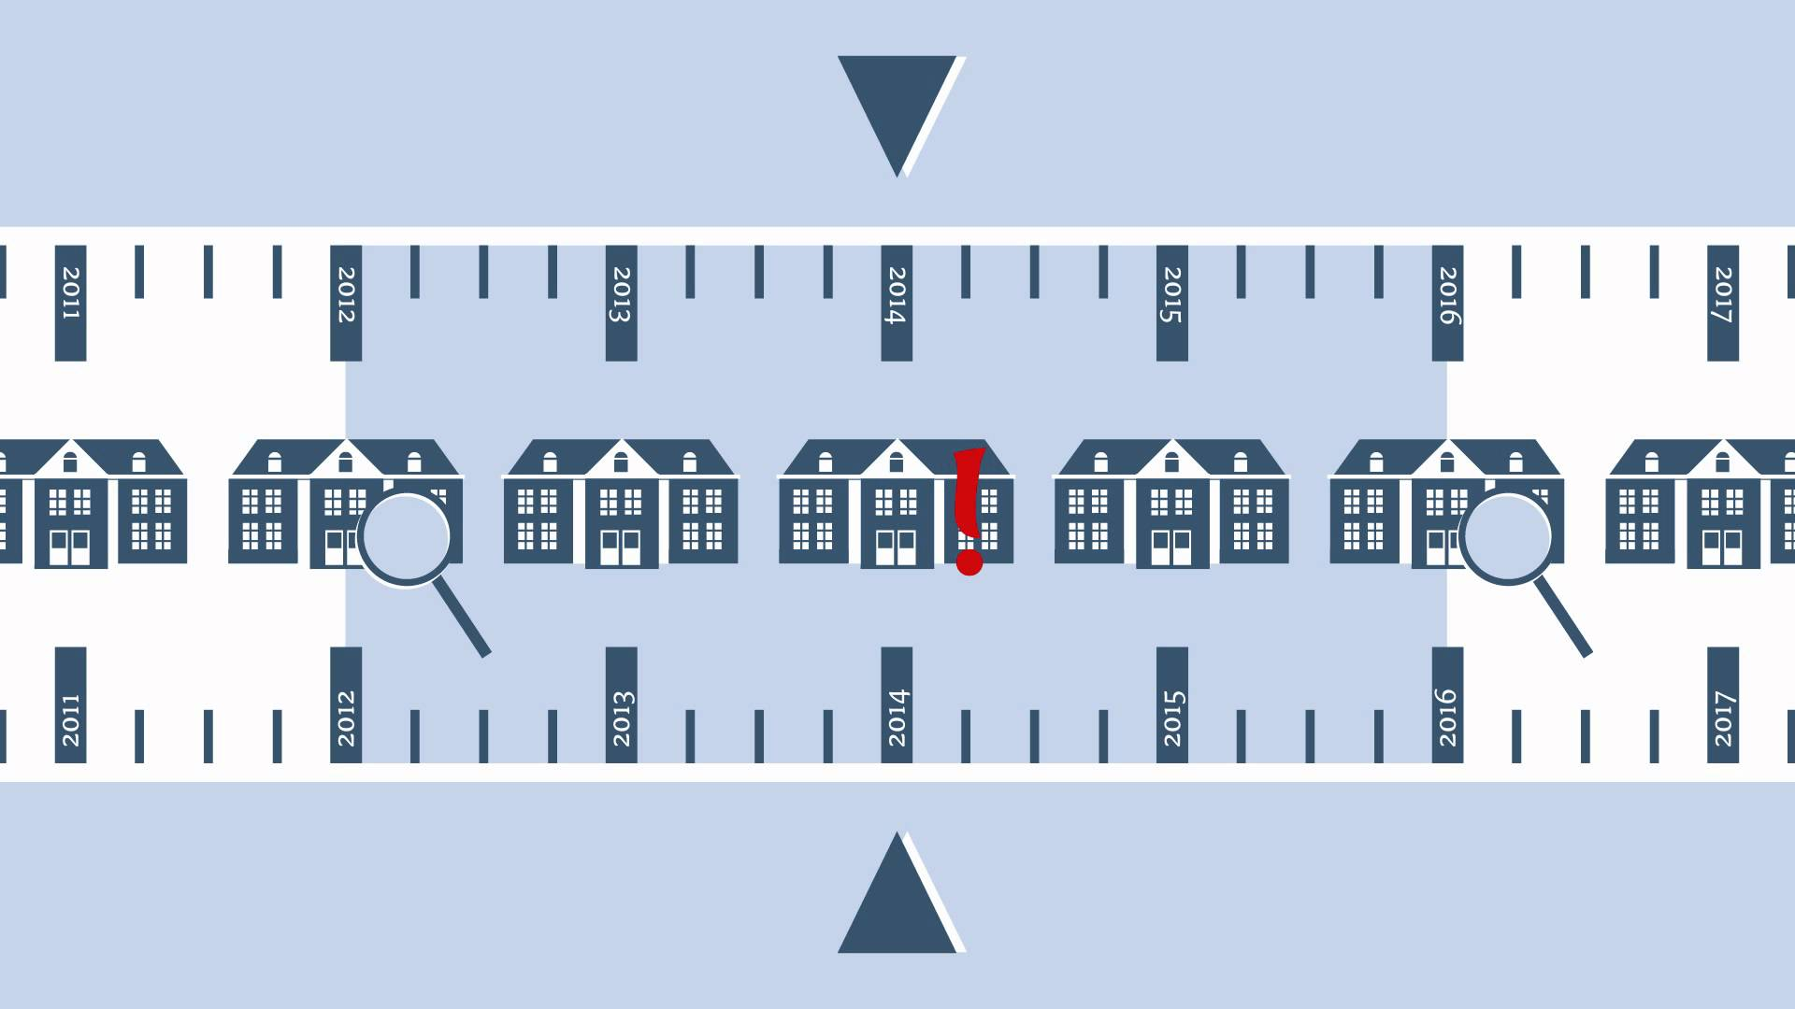
Inspectorate of Education

Slide 5


Accountability of the results to the superintendent of Education https://www.scholenopdekaart.nl/basisscholen/11979/Rooms-Katholieke-Basisschool-t
Schrijverke?postcode=5237ne&presentatie=1&sortering=2

Slide 6
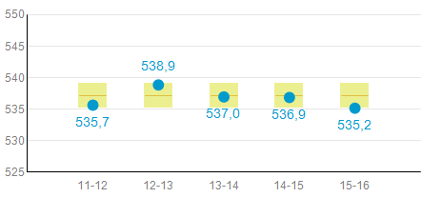

Slide 7

valuation report of inspection, once every 4 years
Legend:
1. worse
2. inadequate
3. sufficient
4. good

Slide 8

Results | 1 | 2 | 3 | 4
results final test |  |  | x
results during the year, reading, grammar and mathematics |  |  | x
social skills |  |  | x

Slide 9

Counseling | 1 | 2 | 3 | 4
Instrument of tracking the development of pupils |  |  |  | x

Slide 10

Care | 1 | 2 | 3 | 4
Early warning |  |  |  | x
Analysis and making plans |  |  | x
Implementing en taking care that plans are realised |  |  |  | x
Evaluation of the effects of the plans |  |  | x

Slide 11

Quality measurement | 1 | 2 | 3 | 4
Understanding of the educational needs of the population |  |  | x
Annual performance review |  |  | x
Evaluation the educational process |  |  |  | x
Systematic work on improvements |  |  |  | x
Securing quality of education |  |  | x
Deliver accountability to stakeholders |  |  |  | x

Slide 12

In connection to the programmatic enforcement the inspection has added some extra checks on certain legal requirements.
Whether the school may or may not meet these legal requirements is expressed with the score
Regulations | yes | no
Schoolplan | x
Year plan | x
Sufficient teaching time | x
Not more than 7 weeks an incomplete school week | x

Slide 13

Accountability Board of Directors
1. leadership, management,
through audits and performance reviews
2. accountability for results during the year
3. educational process, making plans every year.
4. staff, every year consulting the staff manager of the board
5 finance, every year a review about results and approval of the
budget for the new year
6 inflow and outflow of pupils
7. satisfaction of parents and pupils

Slide 14

Accountability to parents and pupils
1. annual results
2. once in two years a
research on safety, education
and leadership

Slide 15

selfregulation
1. ask feedback to the pupils and their parents,
with a special program
2. analyse the results and make plans for progressing
3. research of the practice and scientific support
4. performance reviews

Slide 16


This work is licensed under a Creative Commons Attribution-NonCommercial 4.0 International License.

