Slide 1



Self-Evaluation
UK Presentation
A presentation from the United Kingdom.

Slide 2
Contents
Why use self-evaluation?
History and development of self-evaluation
What do we do at Branston Junior Academy?

Slide 3
Why use self-evaluation?
To examine current practice and policy, to discover what the current strengths and concerns are.
To examine how well you are achieving your targets in your current ‘School Improvement Plan’.
To ensure that you have gathered evidence and opinion from all stakeholders. (Pupils, Parents, Staff, Governing Body, Local Community etc)
To evaluate impact of expenditure.

Slide 4
To ensure you have looked at all aspects of the school.
To be able to report back to the Governing Body on current strengths and concerns.
To identify future targets for the next ‘School Improvement Plan’ and future budget expenditure.
To be able to provide evidence of regular self-evaluation to the Ofsted inspectorate.

Slide 5
History and development of self-evaluation
Knowledge of school based on test results and internal data, etc.
The rise of the dreaded SEF - 28 questions to answer and evidence in detail !!
Set format, but less evidence needed – still fairly unmanageable.
Now up to headteacher (and Senior Leadership Team) to decide how self-evaluation will be carried out and evidenced.
Notes:
1) In the 9 years that I have been a headteacher, the role of self-evaluation has increased in importance.
As DHT, I observed how HT’s moved away from simply knowing what their school was good at (eg; test results and internal data analysis)….. …to the rise of a mammoth document which contained 28 questions.!!!!
2) Each question required detailed paragraphs of writing and at least one piece of regularly updated evidence. (Good practice dictated that a headteacher should find 2 or even 3 pieces of evidence for each question!)
The form was known as a ‘SEF’ - or Self-Evaluation Form. Many headteachers left until the summer holidays to complete…but this meant it wasn’t ‘live’; so was it any use?
3) During 2nd year of headship (2009 to 2010) the SEF document became smaller. Had a set format, but less evidence was expected.
I created a system of actions to be carried out at different points in time throughout the academic year to make sure it was a ‘live’ document.
I also started to amend the format to make it easier to complete and read.
4) Ofsted Inspection documentation simply says that amongst other documentation made available to them upon arrival at the school, Inspectors will require:
“a summary of any schools self-evaluation or equivalent”,
a “current school improvement plan or equivalent, including any strategic planning that sets out the longer term vision for the school” and
“records of the evaluation of the quality of teaching, learning and assessment”

Slide 6
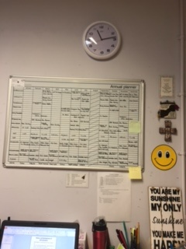
What do we do at Branston Junior Academy?
A planner of activities to be carried out at appropriate times of the academic year.
This ‘annual planner’ is on the wall of my office…so I can see at a moment’s notice, what I need to do each month!

Slide 7
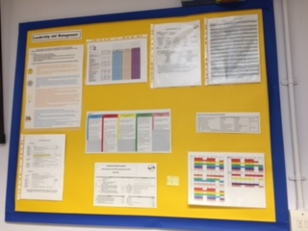
Important sheets on display in my office so I can find information quickly.
These documents include a summary of the targets in the current ‘School Improvement Plan’.

Slide 8
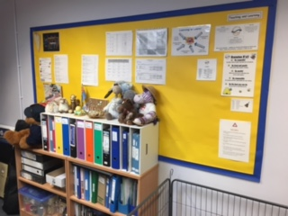
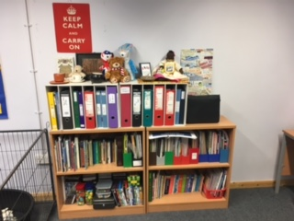
Folders of evidence in my office which I can update regularly – as the different actions in the Annual Planner are carried out etc.
During the October 2016 half term holidays, I went into school to tidy up these folders. I felt I was keeping far too much.
The current system of Ofsted inspection states that they will only be in school for 1 day (unless judged to be Outstanding or Requires Improvement, in which case they’d stay for a second day); so why keep all this paperwork if no-one is going to look at it or use it?

Slide 9
Self-Evaluation and School Improvement Plan.
Previously, I had a ‘Self-evaluation’ document, and a separate ‘School Improvement Plan’.
I felt that all self-evaluation actions should feed into current or future actions and thus should be closely linked to the School Improvement Plan.
To me, having two separate documents did not seem to highlight the close link between the two documents.

Slide 10
The SEaSIP!!
For 2016/17 academic year, I therefore created a new document entitled the SEaSIP. (Self-Evaluation and School Improvement Plan).
This is one document that combines both the self-evaluation of current policy and practice AND the setting of targets for future improvements.
SEaSIP

Slide 11
What kinds of evidence do we use, in order to self-evaluate?
Quality of Teaching, Learning and Assessment (TLA) | Personal Development, Behaviour and Welfare | Leadership and Management | Outcomes for Pupils | Engagement with Pupils and Community
TLA Audits; whereby SLT examine books, data, planning, classroom displays and observe lessons. | Health and Safety Audits / walk-rounds / inspections. | Minutes of Governing Body meetings; particularly when they get involved in any SE activities. | Results from external tests; including measuring the ‘gap’ between disadvantaged pupils and non. | Parental questionnaires and surveys.
Regular internal data analysis. | Pupil interviews. | Monitoring of budget expenditure; including ‘impact of expenditure’. | Results from internal data analysis.; including measuring the ‘gap’ between disadvantaged pupils and non. | Pupil interviews
Analysis of external tests. | Scrutiny of behaviour records (including bullying, racism and exclusion; if appropriate) | List of Staff meeting themes and minutes of same. This includes information on staff training. |  | Impact reports from collaborative partnership work with other schools.
Regular reviews of effectiveness of curriculum | Gathering evidence of specific activities and events carried out that promote better behaviour; including assembly themes,c ompetitions, e-safety activities, RE/PSHE activities etc. | HT Appraisal . Staff Appraisal. |  | Erasmus+ (and other similar international) impact reports.
Regular surveys to parents, staff, pupils etc. Pupil Interviews. | Documentation used to investigate incidents that happen in school. (This might include letters from parents etc). | Scrutiny of impact of actions to support disadvantaged and SEND children.

Slide 12


This work is licensed under a Creative Commons Attribution-NonCommercial 4.0 International License.

