Slide 1

School Evaluation
I Społeczne Liceum Ogólnokształcące
im. Unii Europejskiej in Zamość

Slide 2
What is school evaluation?
(according to educational law)
the process of:
collecting
analysing
communicating information
evaluating activities undertaken by the school
Notes:
(ENELAIZING)

Slide 3
Types of school evaluation
External school evaluation
Internal school evaluation
Teacher’s self-evaluation

Slide 4

Teacher’s self-evaluation

Slide 5
Teacher’s self-evaluation
substantive competence
methodological competence
educational competence
objective: to increase the level of professionalism
Notes:
There are three areas of teacher’s self-evaluation:
substantive competence (KOMPITENS) in the taught (TOT) subject – kompetencje merytorczne
methodological competence (KOMPITENS), for example, activities, teaching methods, techniques, group work, project work;
educational competence (KOMPITENS) – for example communication, understanding of certain age groups’ problems, the ability to keep discipline and getting on well with a group – kompetencje wychowawcze
objective: to increase the level of professionalism

Slide 6
Tools of teacher’s self-evaluation
Self-assessment sheets
Feedback from students
Feedback from parents
Evaluation by the Headteacher
Information from other teachers (lessons observed by other teachers)
Portfolio
Notes:
Self-assessment sheets. (arkusz samoceny) Feedback from students. Feedback from parents. Evaluation by the Headteacher (hospitacja). Information from other teachers (lessons observed by other teachers). Portfolio.

Slide 7
Example of teacher’s self-evaluation
Was my knowledge of the subject matter sufficient?
Was the lesson interesting, and the content useful?
Did I adjust the methods to the particular issue and class?
Did I use the students’ knowledge to introduce the new ideas?
Was the lesson logically planned and was it conducted according to it?
Had I prepared appropriate materials and educational tools?
Did I make it possible for the students to work individually?
Were the students interested in the lesson and did they reach the planned objectives?
Was I enthusiastic enough to encourage the students to make some effort?
Is my assessment fair, is it based on the current progress or am I only correcting mistakes?
Am I able to listen to someone else's opinion?
Notes:
Was my knowledge of the subject sufficient? (SAFISZINT)
Was the lesson interesting, and the content useful?
Did I use the right methods to the particular issue and class?
Did I use the students’ knowledge to introduce the new ideas?
Was the lesson logically planned and was it conducted according to plan?
Had I prepared correct materials and educational tools?
Did I make it possible for the students to work individually?
Were the students interested in the lesson and did they reach the planned goals?
Was I enthusiastic enough to involve the students in the lesson?
Is my assessment fair, is it based on the current progress or am I only correcting mistakes?
Am I able to listen to someone else's opinion?
Czy moja znajomość przedmiotu była wystarczajca?
Czy lekcja była interesująca, a przekazywana wiedza użyteczna?
Czy dostosowałem metody do zagadnienia i klasy?
Czy wiązałem nowe wiadomości z tym, co uczniowie już znali?
Czy lekcja została logicznie zaplanowana i przebiegała zgodnie z tym planem?
Czy przygotowałem zawczasu odpowiednie materiały i środki dydaktyczne?
Czy stworzyłem uczniom możliwość samodzielnej pracy ?
Czy uczniowie byli zainteresowani lekcją i osiągnęli zaplanowane cele?
Czy nie zabrakło mi entuzjazmu, czy zachęcałem uczniów do wysiłku?
Czy moje oceny są sprawiedliwe
Czy oceniając diagnozuję postępy i stan, czy też tylko poprawiam błędy?
Czy potrafię wysłuchać czyjegoś zdania?

Slide 8
Strengths and weaknesses of Teacher’s self-evaluation
-
no professional instruments for testing
not obligatory
+
not obligatory
increase of the level of professionalism
subjective rating
for personal use only
Notes:
subjective rating

Slide 9

Internal School evaluation

Slide 10
Internal school evaluation
obligatory in public / state schools
useful results (concept of the school development)
element of the Headteacher’s pedagogical supervision
collecting information of the school activity in different areas
areas recognized as important
Notes:
The main characteristics of internal school evaluation are
obligatory in public / state schools. It is not obligatory in our school – we can do it but we don’t have to.
element of the pedagogical supervision conducted by the Headteacher
Collected information gives evaluation of the activities of the school in different areas
Areas / domains of evaluation depend on the headmaster’s or teachers’ priorities
Some areas of evaluation may be recognized in the school as important
The results should be analysed to prepare the concep of the school development

Slide 11
Stages of school internal evaluation
Preparation
selection of the subject
planning activities
Implementation
data collecting
Summary
data analysis
evaluation plan
drawing conclusions
the final report presentation
Notes:
The evaluation consists of three stages
The preparation:
selection of the subject
planning activities
designing the evaluation plan
Implementation –
data collecting (DEJTA)
Summary –
data analysis (DEJTA ENELASIS)
drawing conclusions
Preparing for the final report presentation

Slide 12
Tools of school evaluation
diagnostic sheets and surveys
interviews
evaluation survey
observations
group discussions
Notes:
Narzędzia wykorzystywane w ewaluacji wewnętrznej

Slide 13
Strengths and weaknesses of school internal evaluation
-
conducted by teachers
time-consuming
+
more accurate than the external one
type of school autonomy
risk of subjective results’ interpretation
Notes:
-
conducted by teachers – they are not professionals in the research area
time consuming – teachers spend a lot of time preparing evaluation tools, collecting and analysing data and preparing the report
risk of subjective results’ interpretation - teachers – researchers are sometimes not objective
+
more accurate than the external one - fits in the school reality
type of school autonomy

Slide 14

External School evaluation

Slide 15
External school evaluation
It is in accordance with the educational law;
The Ministry of Education has defined 12 requirements the schools have to meet;
Evaluation may concern:
all the requirements – so called, overall evaluation
some chosen requirements – specific problem evaluation;
The evaluation results are published in the report available on the platform www.npseo.pl;
The external evaluation of the specific institution is conducted by a team of inspectors;
The evaluation lasts for a few weeks and is divided into three stages:
Preparation
Evaluation at school
Summary
Notes:
It is in accordance with the educational law
The Ministry of Education has defined 12 requirements the schools have to meet
Evaluation may concern:
all the requirements – so called, overall evaluation
some chosen requirements – specific problem evaluation
The evaluation results can be seen in the report on the platform www.npseo.pl.
The external evaluation of the specific institution is conducted by a team of inspectors
The evaluation lasts for a few weeks and is divided into three stages:
Preparation
Evaluation at school
Summary
Wynika z przepisów prawa oświatowego
Ministerstwo zdefiniowało 12 wymagań wobec szkół
Ewaluacja może obejmować:
wszystkie wymagania– tzw. ewaluacja całościowa
wybrane wymagania – ewaluacja problemowa
Wyniki ewaluacji przedstawiane są w raporcie dostępnym na platformie internetowej www.npseo.pl.
Ewaluacji zewnętrznej danej placówki dokonuje zespół wizytatorów.
Badanie trwa kilka tygodni i dzieli się na trzy etapy:
Przygotowanie
Badanie w szkole
Podsumowanie

Slide 16
Requirements for schools
The school or institution implements the concept of work aimed at the students’ development;
The educational process is organised in a way supporting learning;
Students gain knowledge and skills that are specified by the school curriculum;
Students are active;
Attitudes are shaped and social norms are respected;
The school or institution promotes the students’ development, taking their individual situation into considertion;
Teachers take active part in educational processes’ planning and implementation;
Notes:
Requirements for schools
The school or institution implements the concept of work aimed at the students’ development.
The educational process is organised in (ORGENAJZD) a way supporting learning
Students gain knowledge and skills that are specified by the school curriculum
Students are active
Attitudes are shaped and social norms are respected
The school or institution promotes the students’ development, taking their individual situation into considertion
Teachers take active part in educational processes’ planning and implementation
Wymagania wobec szkół
Szkoła lub placówka realizuje koncepcję pracy ukierunkowaną na rozwój uczniów.
Procesy edukacyjne są zorganizowane w sposób sprzyjający uczeniu się
Uczniowie nabywają wiadomości i umiejętności określone w podstawie programowej
Uczniowie są aktywni
Kształtowane są postawy i respektowane normy społeczne
Szkoła lub placówka wspomaga rozwój uczniów, uwzględniając ich indywidualną sytuację
Nauczyciele współpracują w planowaniu i realizowaniu procesów edukacyjnych

Slide 17
Requirements for schools
The value of education is promoted;
Parents are the partners of the school or institution;
The school, institution and community resources are used for the mutual development;
The analysis of the standarized external exam results (primary school, junior-high school, high school leaving exams and vocational qualification exam) and other internal/external evaluation results are taken into consideration by the school or institution while organising the educational process;
The management of the school or institution fosters their development.
Notes:
The value of education is promoted
Parents are the partners of the school or institution
The school, institution and community resources are used for the mutual development
The analysis of the standarized (STENDERAIZD) external exams results (primary school, junior-high school, high school leaving exams and vocational qualification exam) and other internal/external evaluation results are taken into consideration by the school or institution while organising the educational process
The management of the school or institution fosters their development
8. Promowana jest wartość edukacji
9. Rodzice są partnerami szkoły lub placówki
10. Wykorzystywane są zasoby szkoły lub placówki oraz środowiska na rzecz wzajemnego rozwoju
11. Szkoła lub placówka, organizując procesy edukacyjne, uwzględnia wnioski z analizy wyników sprawdzianu, egzaminu gimnazjalnego, egzaminu maturalnego i egzaminu potwierdzającego kwalifikacje w zawodzie oraz innych badań zewnętrznych i wewnętrznych
12. Zarządzanie szkołą lub placówką służy jej rozwojowi

Slide 18
Two levels of meeting the requirements
BASIC
certifies that the educational process is conducted in a proper way, enabling each student to develop and each school/institution to increase their activity;
HIGH
certifies high efectiveness of the activities undertaken by the school/institution, confirmed by educational results, positive perception by the community and the school/institution’s development.
Notes:
Two levels of meeting the requirements
BASIC
certifying that the educational process is conducted in a proper way, enabling each student to develop and each school/institution to increase their activity;
HIGH
certifying high efectiveness of the activities undertaken by the school/institution, confirmed (KONFEMD) by educational results, positive perception by the community and the school/institution’s development.
Dwa poziomy spełniania wymagań
PODSTAWOWY
świadczy o prawidłowym przebiegu procesów kształcenia, wychowania i opieki umożliwiającym każdemu uczniowi rozwój, a szkole/placówce doskonalenie swojej pracy;
WYSOKI
świadczy o wysokiej skuteczności działań, wyrażanej efektami kształcenia i wychowania, pozytywnym postrzeganiem szkoły lub placówki oraz jej rozwojem i uspołecznieniem.

Slide 19
The evaluation participants
students
school employees
the management (headmaster)
representatives of the managing institution
local community representatives
parents
Notes:
In the process of evaluation all the information has to be confirmed (KONFEMD) by all the involved groups, to prove the information is true.
Wszystkie uzyskane informacje muszą być potwierdzone przez wszystkie badane grupy, aby zostały uznane za prawdziwe

Slide 20
Tools of school evaluation
survey
in-depth interview
focus group interview
group interview with teachers
lesson observation
group interview with students
individual interview
school observation
post-observation interview
‘desk research’
Notes:
Tools used in external evaluation
Narzędzia wykorzystywane w ewaluacji zewnętrznej

Slide 21
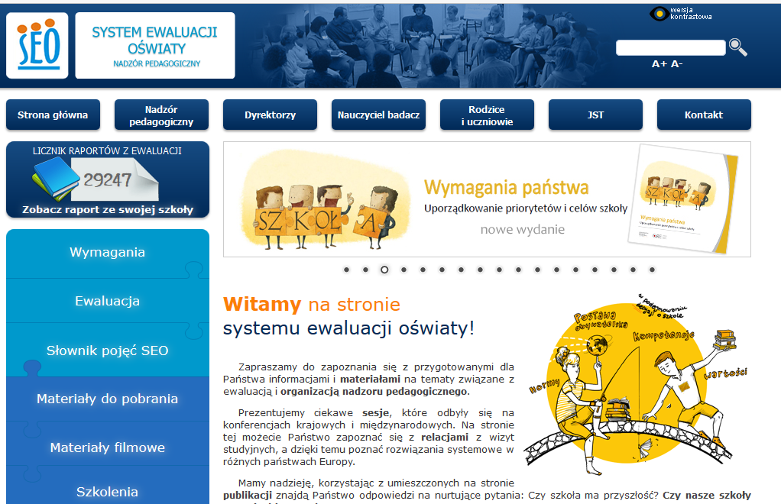
Educational evaluation system website
Notes:
Tools used in external evaluation
Narzędzia wykorzystywane w ewaluacji zewnętrznej

Slide 22
Strengths and weaknesses of school external evaluation
-
complicated language of surveys/interviews
+
ready standarized tools
the need to prepare
time-consuming
disruption of school work
the possibility to prepare
dedicated platform
Notes:
-

Slide 23

OTHER FORMS OF EVALUATION

Slide 24
Other forms of external school evaluation
The Added Value od Education
Press rankings
External exam results
Notes:
Prepared by various institutions without the school itself, based on the external data
Opracowywane przez różne instytucje bez udziału szkoły i w oparciu o dane zbierane zewnętrznie

Slide 25


thank You
This work is licensed under a Creative Commons Attribution-NonCommercial 4.0 International License.

