Slide 1
Evaluation
Internal Evaluation of the centers according to the Current Regulations.

Slide 2

There are no rules in Spain concerning the regulation of internal evaluation of the centers. However, you can find the requirement of the evaluation in several articles of the Organic Law of the Improvement of the Educational Quality Standards (LOMCE).

Slide 3

Among the powers the law grants to the School headmaster is:
To encourage Internal Evaluations of the Centers and collaborate in External Evaluations as well as in Teacher Evaluation (LOMCE, Art. 132 h)

Slide 4

Among the powers that the Law provides to the School Board is:
Evaluate the general annual Program of the Center, without causing any prejudice to the Competences of the Faculty of Teachers with regard to the planning and teaching organization (LOMCE, Art. 127 b).

Slide 5

Analyze and evaluate the general functioning of the Center, the evolution of school performance and the outcomes of the internal and external evaluations in which the Center takes part (LOMCE, Art. 127 j)

Slide 6

Elaborate proposals and reports by its sole initiative or upon a competent Administration request with regard to the operation of the Center and the improvement of the quality standards of the management, as well as with other matters concerning quality improvement. (LOMCE, Art. 127 k)

Slide 7
Internal evaluation is based in four different ambits.

Slide 8
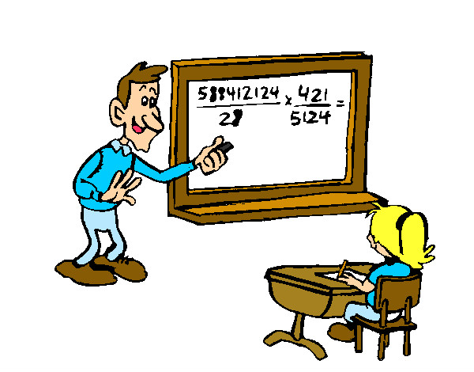



Internal Evaluation
Teaching and learning process
Organization and operation
Relationship with our environment
Continuous teacher training and innovation

Slide 9
Annual
General Program
Internal Evaluation
Improvement Proposals
Activities
Annual Report

Slide 10




Anual report
General School Board
Parents (Volunteer)
Educative Inspection
Economic Inspection

Slide 11
School´s Educational Plan (for several years)
Annual
General Program

Slide 12
Didactic groups working plan
School Board working Plan
New teachers, students, and parents welcome plan
Bilingualism plan
Cultural tours Plan
Coexistence Improvement Plan
Anual General Targets
Reading and writing improvement Plan
Free time Education Plan
Tutorial accompaniment Plan
Direction Team Working plan
Other needs student accompaniment Plan
Teachers senate Working Plan
Academic and Labour Guidance Plan
ICT leader working plan
Pedagogical coordination Comittee working Plan
Religion Team working plan
External evaluation results improvement plan
Arts PLan

Slide 13


Thank you
This work is licensed under a Creative Commons Attribution-NonCommercial 4.0 International License.

