Slide 1


Managing for @ school of success
Programa de Apoio à Avaliação do
Sucesso Académico
(Academic Success Evaluation Support Program)

Slide 2
Academic Success Evaluation Support Program
Support to the development of practices for the evaluation of academic results

Slide 3
Program aims
Institutionalize, in the routines of the school, the evaluation of Academic Success;
Promote the development of the Academic Success evaluation;
To give coherence and intentionality to the evaluation of Academic Success;
Transform the evaluation of Academic Success into a process capable of fostering improvement and assisting accountability.

Slide 4
Methodology: referencing
Allows the construction of contextualised school evaluation devices
Transforms analysis practices into real evaluation practices, because, by giving them coherence and intentionality, it favors the regulation of educational action, transforming them into evaluation practices of full right

Slide 5
“Critical friend”
Analyze the evaluative action that is being developed in school
Collaborate with the Internal Team in the construction of possible strategies to improve or reinforce good practices
Value and legitimize the evaluation action that is being developed in the school

Slide 6
structure
School Evaluation Team
Builds the Referential
Promotes data collection
Promotes evaluation
Build the report

Slide 7
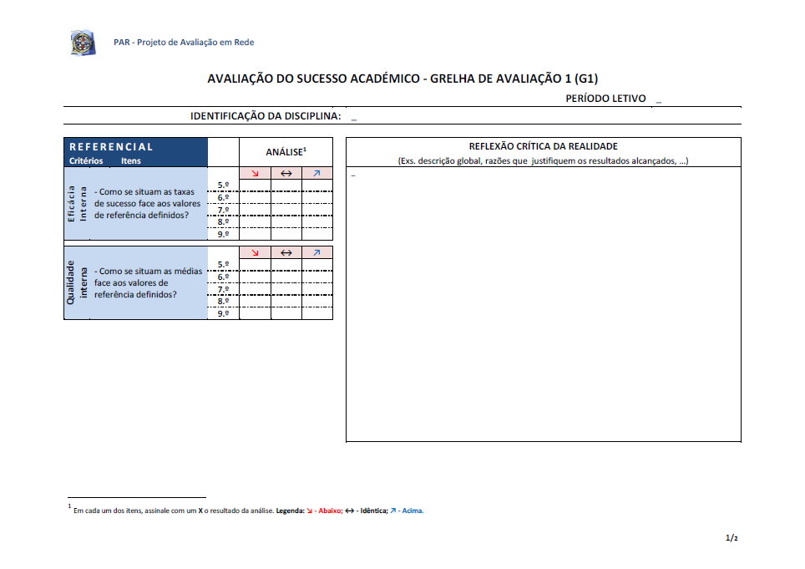
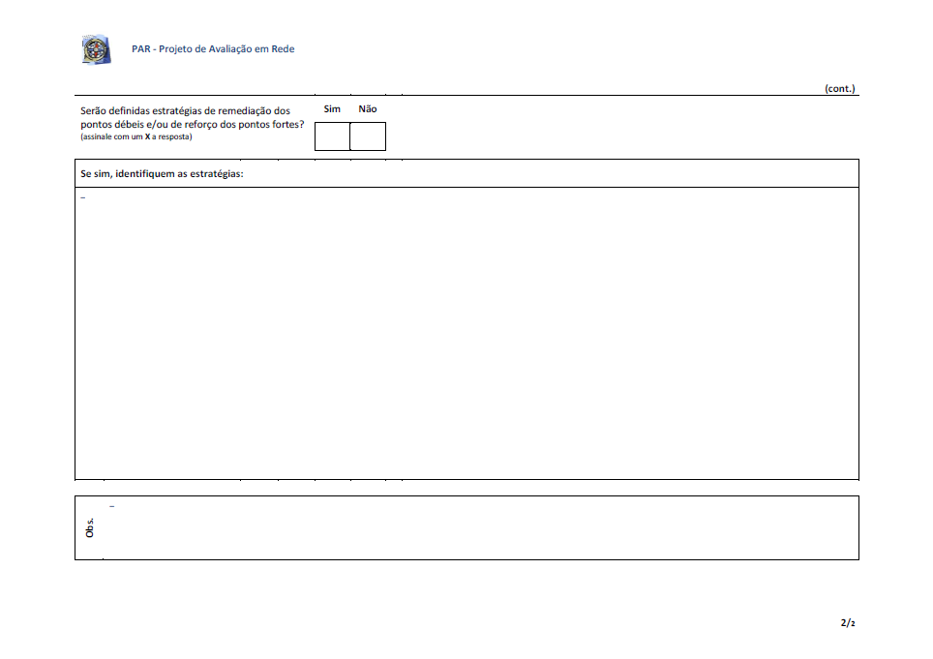
Evaluation and critical reflection grids

Slide 8
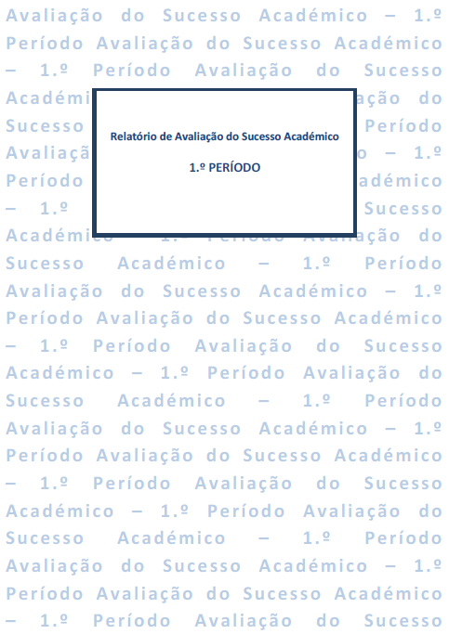
School Evaluation Team presents the report
Pedagogical council validates and disseminates the report: promoting improvement
Headmaster presents the report to the General Council: accountability
Evaluation report of academic success

Slide 9
In order for the school to become a learning organization, it will be necessary to learn how to learn*
*Thurler, M. T. (2000). Innover au coeur d l’établissement scolaire. Paris: ESF, p. 196

Slide 10


This work is licensed under a Creative Commons Attribution-NonCommercial 4.0 International License.

