Slide 1
Nelas GROUP OF SCHOOLS
INTERNAL EVALUATION PRACTICES

Slide 2
AENELAS - What makes the difference?
Educational project
Internal Regulation
Annual action/
activity plann
Budget

Slide 3
Nelas School Educational Project
Mission
Vision
Values
To have a public service of quality to promote the best conditions so that all the learners have the same and equal opportunities in the learning process
To achieve equity and excellence by giving each student the opportunity to develop his skills and knowledge and to explore all his capacities to become a full citizen
To foster a culture of responsibility, work and personal effort, resilience, autonomy, respect, solidarity, mutual aid and discipline.

Slide 4
AENELAS - GOALS AND PRIORITIES
Promote students’ success
Develop students’ skills to become a successful citizen
Privilege the approach between school and community
Promote the best school climate
Ensure the effectiveness of management and organizational processes
Promote a self-assessment culture
Promote the development of the learning process
Promote reading and literacy skills
Foster equity as fairness and inclusion

Slide 5
THE PURPOSE OF INTERNAL EVALUATION
To identify strengths and areas for IMPROVEMENT
To meet ACCOUNTABILITY requirements
To create KNOWLEDGE about what works, for which students and why
To achieve equity and excellence in outcomes for all learners

Slide 6
INTERNAL EVALUATION IN PORTUGAL
The law requires that schools create and/or adopt more or less open or structured models adapted to their educational contexts.
These models help schools to…
- choose assessment indicators and tools to be used in context
- identify its strenghs and improvement areas.
- make the diagnosis of its performance.
- define a few improvement plans to reach excelence.
REFERENCES

Slide 7
INTERNAL EVALUATION MODEL OF NELAS GROUP OF SCHOOLS

Slide 8
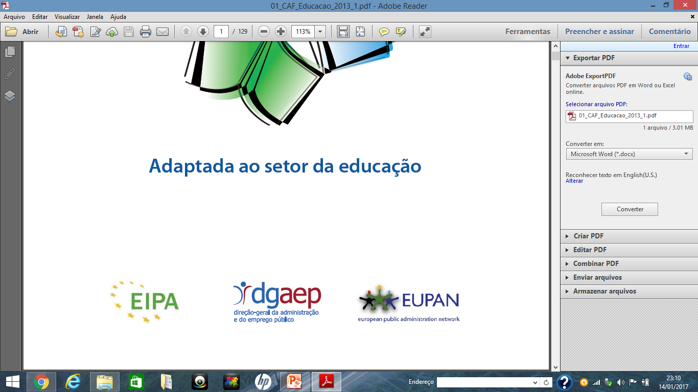
The CAF model
(Common Assessment Framework)
Education

Slide 9
The CAF Model
The CAF is an easy-to-use, free tool to assist public-sector organisations across Europe in using quality management techniques to improve their performance.
The model is based on the premise that excellent results in organisational performance, citizens/customers, people and society are achieved through leadership driving strategy and planning, people, partnerships, resources and processes.
It looks at the organisation from different angles at the same time; a holistic approach to organisation performance analysis.
EVALUATION MODEL

Slide 10
REASONS FOR THE APPLICATION OF the CAF and Education MODEL in AENELAS
THE GROUP OF SCHOOLS WAS CREATED IN 2010 and ….
- There was a large range of documents/ reports about….
- results (outcomes)
- activities performed by students
- activities performed by teachers
- ….
Specific indicators should be defined for analyses
A global model was missing in order to organize information and make it easier to analise and draw conclusions.
- Improvement plans were not structured in the same way.
EVALUATION MODEL

Slide 11
REASONS FOR THE APPLICATION OF the CAF and Education MODEL
The CAF – education model
ranges from the pre-school level to higher education and lifelong learning
can be adapted to specific needs and contextual circumstances of the school
9 criteria and 28 subcriteria allows to have a global view of school as a whole
is intended for all teaching and training institutions in Europe
leadership, strategy and planning, people, partnerships and resources.
EVALUATION MODEL
the implementation process, the structure of the model as well as one of the assessment panels have to be maintained
BUT

Slide 12
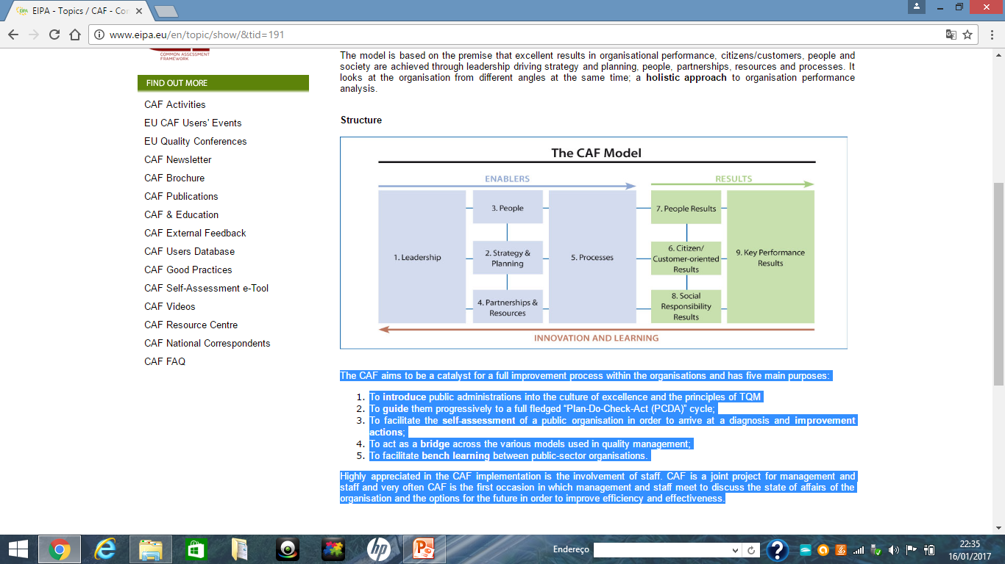
Purpose of CAF self-assessment process
THE IMPROVEMENT IN THE OVERALL PERFORMANCE OF THE ORGANIZATION
EVALUATION MODEL

Slide 13
Criteria, sub-criteria and indicators
1.What leadership is doing to…
- develop the school mission, vision and values
- motivate and support the people who work in the school
2.What the institution is doing to ….
- develop strategy and planning taking into account the gathered information
- communicate and implement strategy and planning in the whole organisation and review it on a regular basis
- plan, implement and review innovation and change
EVALUATION MODEL
ENABLERS

Slide 14
Indicators – criteria and sub-criteria
Criteria, sub-criteria and indicators
3.What the institution is doing to ….
- plan, manage and improve human resources transparently with regard to strategy and planning
- involve emplyees by developing open dialogue and empowerment, supporting their well-being
4. What the institution is doing to ….
- develop and manage partnerships with relevant institutions; - manage finances; - manage information and knowledge; - manage technology; - manage facilities
5. What the institution is doing to ….
- Identify, design, manage and innovate processes on na ongoing basis involving the skateholders
EVALUATION MODEL
ENABLERS

Slide 15
Indicators – criteria and sub-criteria
Criteria, sub-criteria and indicators
6 and 7. What the institution has achieved ….
- to meet the needs and expectations of learners and other key stakeholders as well as its people through the results of perception and performance measurements
8. What the institution is achieving …
- regarding its social responsability through the results of perception and performance measurements
9. The results being achieved by education and teaching isntituition, in relation to…
- external results: outputs and outcomes to goals
- internal results: level of efficiency
EVALUATION MODEL
RESULTS

Slide 16
Project leader + self-assessment group
Communicate the project to the actors
Provide/get training for the group
Undertake the sef-assessment
Draw up a report describing the results of the self-assessement
Draft an improvement plan
Bringing together data/information
Using existing tools or developping new ones to gather data
Identifying relevant sources of data/evidence
Seeking different perspectives
Processing data and information
The process of applying CAF - Education
TOOLS
Activity reports
Evaluation (pautas)
Quarterly School Accountability Reports / Success Reports / PAASA)
National rankings
Infoescolas
OTES
IAVE evaluation reports
Statistics of DGEEC
Internal Documents
Observation grids
Satisfaction surveys
TOOLS AND METHODOLOGIES
METHODOLOGIES
Meetings (general council, management, departments and groups, class tutors, class delegates, …)
Satisfaction surveys (teachers, non-teachers, students, parents and guardians)
Interviews (partners)
World coffee (community)
Panels (groups)
Direct observation
Data and information processing….

Slide 17
PEOPLE (employees)
Teachers
Specialized technicians
Operational Assistants
Technical Assistants
LEARNERS (clients)
Students
Parents and guardians??
PARTNERS/STAKEHOLDERS
Municipality
Foundations
Industries
ACTORS
Council of teachers Class councils
Disciplinary groups Curricular departments
Pedagogical council Headmaster
General Council
The process

Slide 18
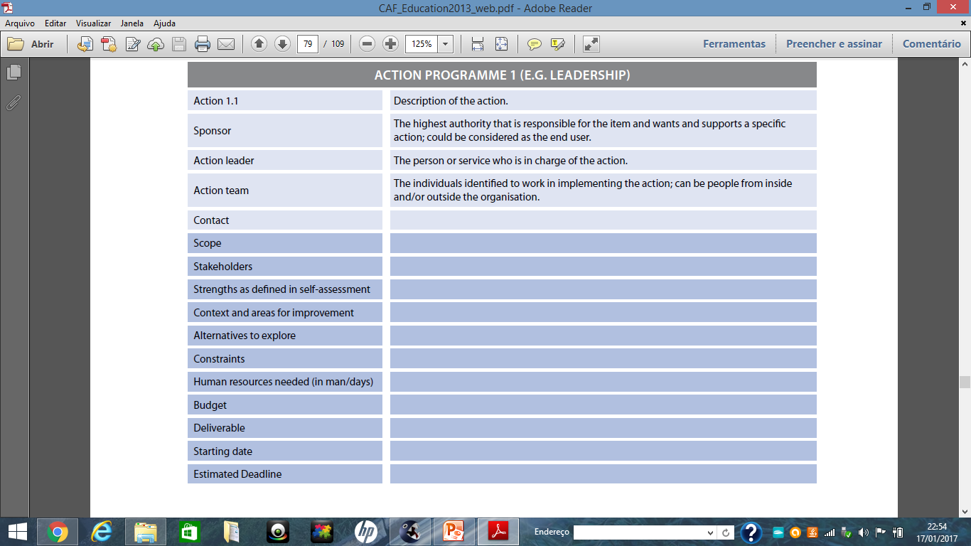
THE IMPROVEMENT PLAN
The action plans resulting from the self assessment should be integrated into the strategic planning process of the school and become part of the overall management of the school.
EVALUATION MODEL

Slide 19
PROBLEMS
It requires a lot of time available to invest in the self-assessment process.
The demands regarding the competences of the project leader are very high:
- a high level of knowledge regarding his/her own organisation,
- knowledge of the CAF model,
- knowledge about how to facilitate the process of self-assessment.
Appropriate project management training must be provided to the team.
It includes a large list of indicators to deal with.

Slide 20
PROBLEMS
The language and examples used in the CAF model are unfamiliar and too far away from our pratice to be used directly.- you have to adapt the model to the language of the school.
The communication efforts regarding the people during the process have to be very well prioritised, otherwise problems may arise in the implementation of model. Communication actions must provide the appropriate information with the appropriate media to the appropriate target group at the appropriate moment – not only before or during but also after the self-assessment.

Slide 21
PROBLEMS
It is advisable that the application process should be completed in three months. Since it took more than one year it raised the risk of reduced motivation and interest of all parties envolved; besides the situation might have changed between the start and the end of the self-assessment process.
Too many people have to be engaged in the process – to get the relevant documents and information, to do the data processing, to implement the improvement plan, to monitor progress and repeat the assessment.

Slide 22
BENEFITS of applying CAF
CAF can be an excellent opportunity to gain more insight into school.
It may get people more actively involved in the school development.
It helps to increase the level of awareness and communication across the school.
It can cover the whole school or separate parts/sectors.
The improvement actions can/should be integrated in the ordinary processes of the school.
The process includes a PDCA (Plan-DO-Check-ACT) to manage improvement actions. It is important to make sure that the changes have a positive effect.

Slide 23


THANK YOU
www.aenelas.edu.pt
This work is licensed under a Creative Commons Attribution-NonCommercial 4.0 International License.

