Slide 1



Self-assessement in school
Helena Castro Jan/FeB – Madrid - 2017

Slide 2
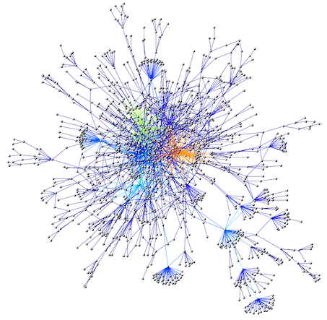
1. The Problem
A Complex field of analysis
Many personal and professional interests involved
Little time to devise tools, to collect information and handle the information collected

Slide 3
Self-assessement
Report
Improvement Plan
Report
Improvement
Plan
2. The Concept
A continuous process of improvement aiming at the vision and mission of schools where we are all co-responsible

Slide 4

3. Set in motion
Created a team with 10 highly motivated teachers from different levels of education
Used the same reference of the General Inspection of Education to define the areas to be evaluated
Developed data collection instruments
Analyze the data

Slide 5
3. Set in motion
Produced a Report with an Improvement Plan
Produced instruments to verify the implementation of the Improvement Plan
New Self-Assessment Report and New Improvement Plan

Slide 6

4. People involved
PARENTS: A survey for 2 representatives of the parents of each class at all levels of education (kinder garden include) (63)
STUDENTS: 1 survey per class from the primary to secondary school (49)
TEACHERS: 1 survey by:
- delegates of curricular group (22)
- coordinator of curricular department (6)
- establishment coordinator (4)
- coordinator of class directors (3)
- coordinator of professional courses (1)

Slide 7

4. People involved
Surveys for:
- OPERATIONAL ASSISTANTS (10)
- TECHNICAL ASSISTANTS (1)
- DIRECTION (1)

Slide 8

4. Selected areas
Satisfaction of the Educational Community – Stakeholders, Parents, Students, Teachers, Intermediate leaders, Other Employees
Quality of Educational Service - Teaching practices, assessment and curricular articulation; Class Directors, Psychology and counseling services and The Special education teachers: impact of their actions.
Management and Leadership - satisfaction of the school community: guidelines and decisions made, relationships with people, conflict resolution

Slide 9
ExamplE

Slide 10

5. Academical success
Another team with 5 highly motivated and treined teachers
Construction of a reference matrix for the analysis of school results
Definition of Internal and external quality and efficacy indicators
Each school period (3 months) an analysis report is drawn up with the reflection of all teachers and stakeholders
The improvement strategies are defined and implemented by the teachers groups

Slide 11

Conclusion
We are in a dynamic of self-learning and inspiration in the complexity of the real.
Thankyou !

Slide 12


This work is licensed under a Creative Commons Attribution-NonCommercial 4.0 International License.

